Slide 1
Comparison of machine learning approaches to model selection in identifying biomarkers of islet autoimmunity in type 1 diabetes
Tim Vigers, Bobbie-Jo M. Webb-Robertson, Howard Davidson, Laura Pyle

Slide 2
Conflict of Interest
I have no current or past relationships with commercial entities.

Slide 3
Background

Slide 4
Type 1 diabetes
Type 1 diabetes (T1D) is an autoimmune disease that leads to destruction of the pancreatic β-cells and loss of insulin production
T1D requires life-long insulin therapy and is associated with complications including cardiovascular disease, kidney disease, and microvascular complications
On average, a 20-year-old male loses 11.1 years and a 20-year-old female loses 12.9 years of life expectancy [@livingstone_estimated_2015]
The global incidence of T1D is increasing by 3-5% annually (ref CDC)

Slide 5
Type 1 diabetes
T1D is typically preceded by development of islet autoimmunity (IA), antibodies against the insulin-producing beta cells of the pancreas
ref: Regnell and Lernmark 2013

Slide 6
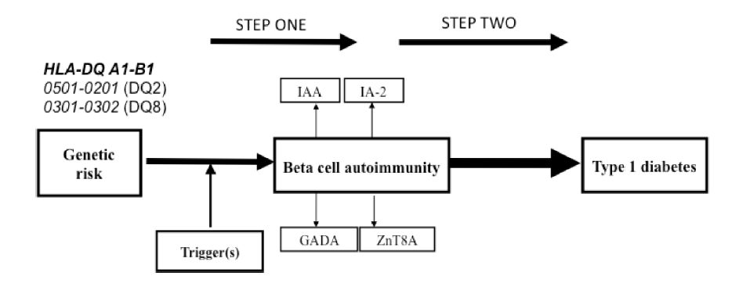

Slide 7
The TEDDY study
The Environmental Determinants of Diabetes in the Young (TEDDY) study is a multinational study with the following aims (ref Rewers 2018):
Identifying environmental factors triggering IA
Identifying biomarkers and predictors of progression to T1D in those with IA
8,676 children with increased risk of T1D were enrolled in the US, Germany, Sweden, and Finland
Children are evaluated for IA every 3 months until development of T1D or 48 months, after which visits are every 6 months

Slide 8
Objective
Our goal was to develop a risk prediction model for IA in TEDDY study participants
Because the pool of potential biomarkers was large and complex, we planned to evaluate three machine learning (ML) approaches to model selection:
An ensemble ML approach
DIFAcTO pipeline [@ref]
Elastic net regression

Slide 9
Methods

Slide 10
Study design
A nested case-control study was performed in 157 case-control pairs
Controls were selected from IA-free participants at the same time point for each case, and were matched by clinical center, sex, and family history of T1D
Potential biomarkers collected include demographics, SNPs, HLA genotypes, dietary exposures, metabolomics, and lipidomics

Slide 11
Ensemble ML approach
Training (N=119) and validation (N=39) test sets were created
Initial screening was performed using paired t-tests
Multiple ML algorithms (logistic regression, naive Bayes classifier, random forest [RF], support vector machine) were applied with 5-fold cross-validation to evaluate the best algorithm
RF was applied to the metabolomic and lipidomic data, and a naive Bayes classifier applied to the other data
Models were merged as the product of the posterior probabilities of each model
Repeated optimization for feature interpretation was used to identify features that best discriminated children who would develop IA

Slide 12
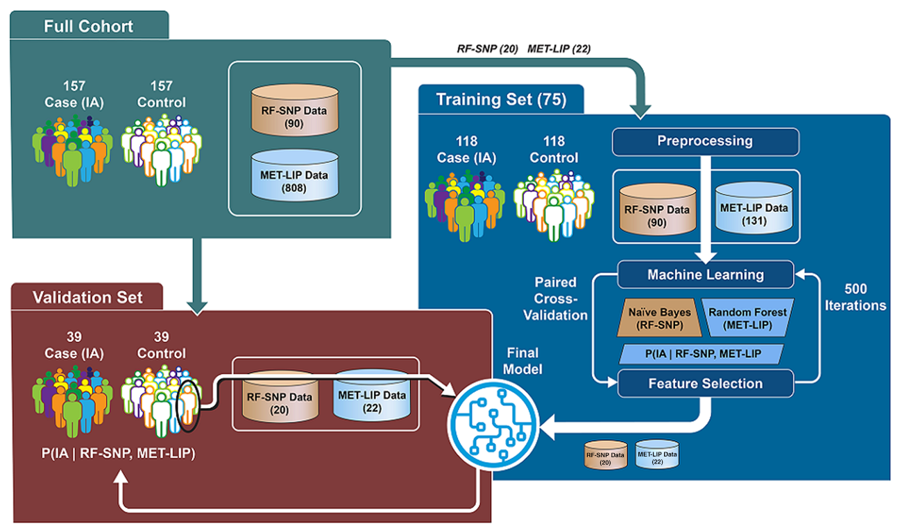
Ensemble ML approach

Slide 13
DIFAcTO pipeline
Data Integration Flexible to Account for different Types of data and Outcomes was originally published as a computational tool aimed at reducing data dimensionality and integrating various data types (ref Speake)
Variables were scaled and clustered using Pearson’s correlation
The variable within a cluster with the strongest association with the outcome was selected to represent the cluster
The minimum within-cluster correlation was selected using cross-validation
LASSO regression was used to perform model selection on the remaining features

Slide 14
Elastic net regression
The elastic net is a regression shrinkage and model selection method that is particularly useful for high-dimensional data with correlated predictors (@Zhou and Hastie)
Elastic net models are parameterized by $λ$, a measure of shrinkage, and $α$, which describes the similarity to ridge and LASSO regression
The ensr package in R (@ref) was used to perform a grid search for $α$ and $λ$ values that minimized the cross-validation error
We chose the smallest model with the cross-validation error that was within 1 SD of the minimum

Slide 15
Simulation methods
To further compare the DIFAcTO pipeline and elastic net regression, we applied these methods to a simulated high-dimensional dataset
We used metabolomic data from the COPD Gene study (@ref) as well as proteomic data from the TODAY study (@ref) to inform our choices of simulation parameters
We simulated 1000 datasets of each of the following scenarios:
50 or 200 features
30, 100, 500 samples
We first generated a random correlation matrix and controlled the sparsity by randomly setting some elements of the correlation matrix to zero, using a probability of a non-zero correlation at 5%

Slide 16
Simulation methods
Means were drawn from a $N\left(1500,830\right)$ distribution and SDs were drawn from a $U\left(1,500\right)$ distribution
We regressed metabolites on age and simulated $β∼N\left(0.002,0.04\right)$, with $ϵ∼N\left(0,8\right)$
We randomly selected features to be included in the simulation model
We evaluated the performance of DIFAcTO and elastic net by calculating the Jaccard similarity and RMSE vs. the true model

Slide 17
Results

Slide 18
TEDDY study results
Algorithm | Number of features | Cross-validated AUC
Ensemble ML | 42 | 0.74
DIFAcTO | 4 | 0.57
Elastic net | 17 | 0.67

Slide 19
Adipic acid and rs2476601 were selected by all 3 approaches
Elastic net and the ensemble ML selected rs6679667, rs6897932, and rs7804356

Slide 20
Simulation results
Features | Samples | DIFAcTO Jaccard Similarity | EN Jaccard Similarity | DIFAcTO RMSE | EN RMSE | DIFAcTO size | EN size
50 | 30 | 0.06 | 0.26 | 20.8 | 3.8 | 7.0 | 14.8
50 | 100 | 0.04 | 0.36 | 24.2 | 6.7 | 5.0 | 12.9
50 | 500 | 0.03 | 0.57 | 25.0 | 7.8 | 3.8 | 8.6
200 | 30 | 0.05 | 0.20 | 14.3 | 3.0 | 16.0 | 20.5
200 | 100 | 0.03 | 0.32 | 23.4 | 6.4 | 10.7 | 14.0
200 | 500 | 0.02 | 0.52 | 24.3 | 7.8 | 7.7 | 10.1

Slide 21
True model size was 5 features

Slide 22
Simulation results
Comments:
EN had higher Jaccard similarity and lower RMSE for all scenarios
EN tended to choose larger models
As N increased, EN JS decreased but D JS decreased slightly
As N increased, RMSE actually tended to increase while model size decreased
As P increased, JS decreased and RMSE decreased, while model size increased

Slide 23
Simulation results
200 features, N=500

Slide 24
Conclusions

Slide 25
Conclusions
The ensemble ML approach had the highest AUC when applied to the TEDDY data, but also selected the largest model
There was little overlap in the features selected in the TEDDY data by the 3 methods
When applied to simulated data, elastic net had higher Jaccard similarity with the true model and lower RMSE compared to DIFAcTO, although it selected larger models
Elastic net encourages a “grouping effect” where strong correlated predictors are kept in the model (Zhou and Hastie)
The DIFAcTO algorithm required significantly longer computational time compared to elastic net

Slide 26
Limitations and future work
Simulations
We assumed MVN distribution for outcomes, linear model, no interactions
We used a random correlation matrix, without structure, although there was not much structure in the COPD Gene data
Examination of additional simulation scenarios, including sparsity and number of features in true model
Further comparison of elastic net and ensemble ML approaches

Slide 27
Acknowledgments
We thank the TEDDY study participants and families for providing data and for participation in the study
Funding from NIDDK, NIAID, NICHD, NIEHS, CDC, JDRF
The ensemble ML work was performed at Pacific Northwest National Laboratory, operated by Battelle for the DOE

Slide 28
References

